Slide 1
LOCAL SEARCH ALGORITHM’S

Slide 2
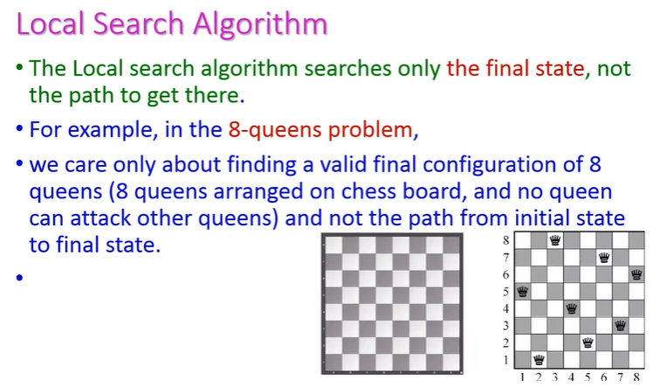

Slide 3
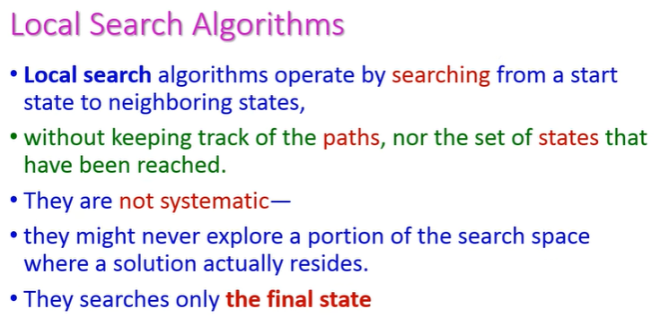

Slide 4
In here we have two variables which are discrete variable and continuous variable.
Discrete variable is a statistical variable which has fixed number of values, coming to continuous variable it has many number of values that are random.
The main goal of continuous variable is solution state is to reach the goal node.
Local Search Algorithm doesn’t matter about path but it only focus on solution state to reach goal node. Example:-Greedy BFS Algorithm.
Local Search Algorithm it will concentrate on a single current node to neighbour's node generally rather than multiple paths

Slide 5
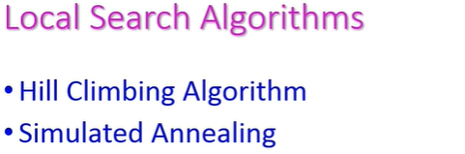

Slide 6
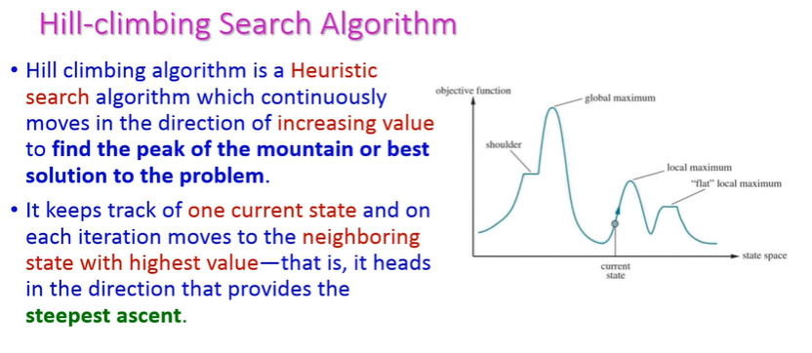

Slide 7
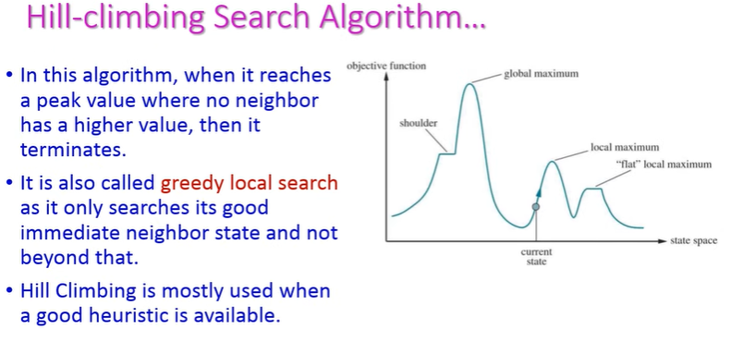

Slide 8
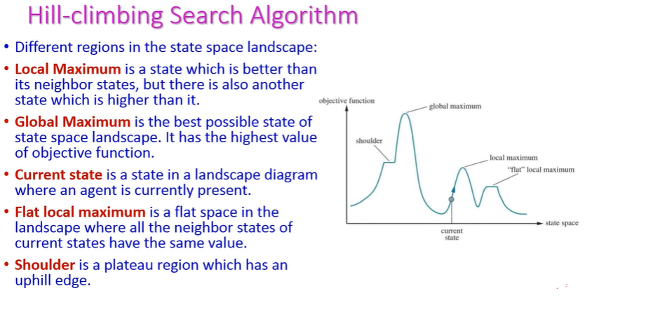

Slide 9
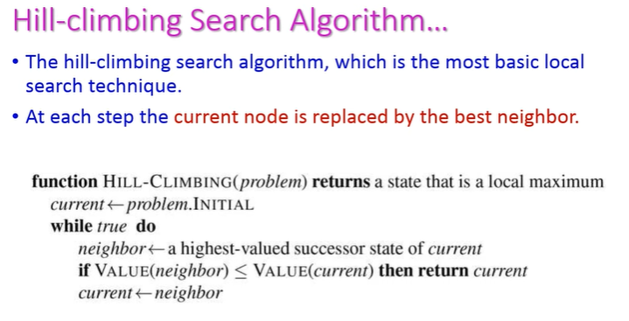

Slide 10
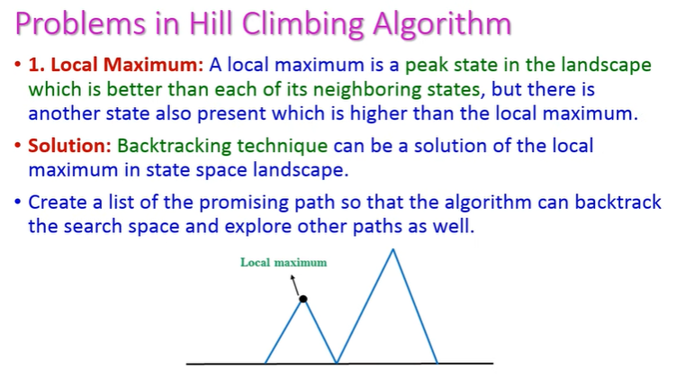

Slide 11
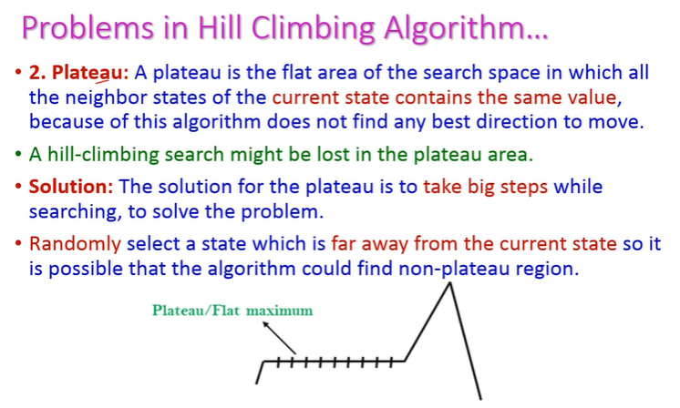

Slide 12
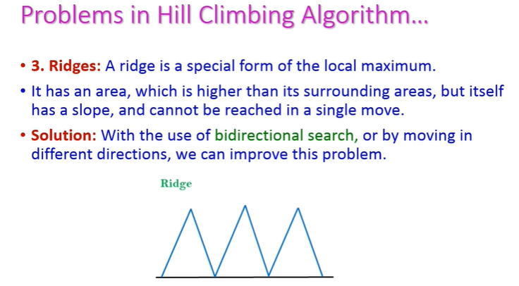

Slide 13
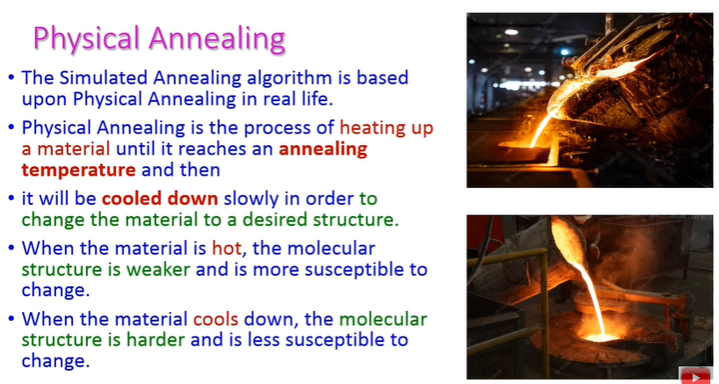
SIMULATED ANNEALING

Slide 14
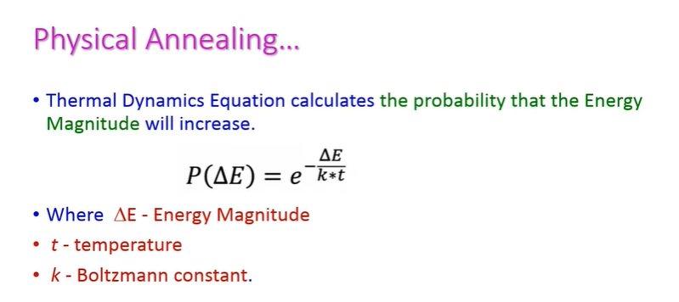

Slide 15
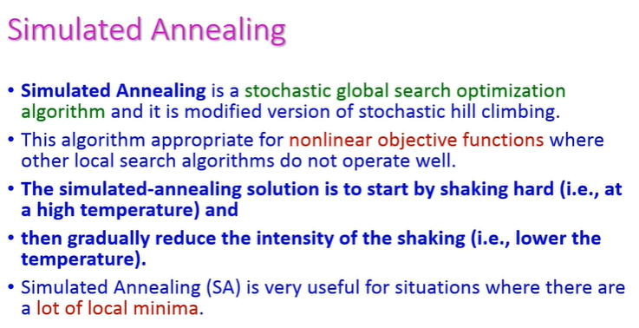

Slide 16
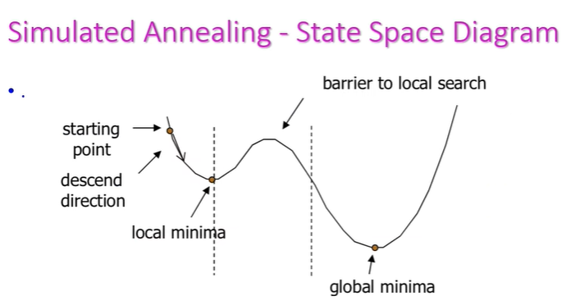

Slide 17
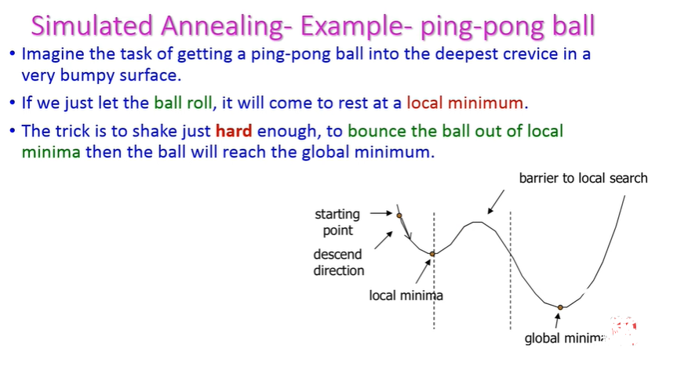

Slide 18
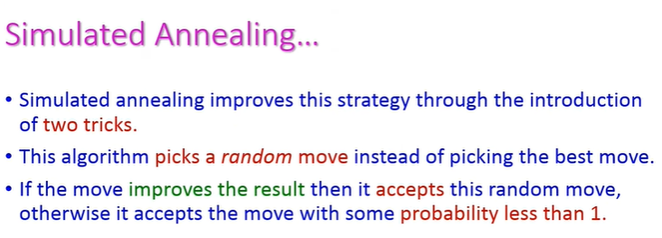

Slide 19
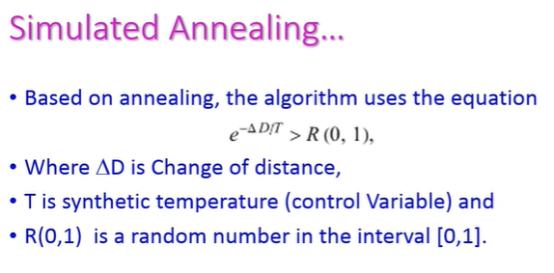

Slide 20
